Slide 1

Make React
Progressive
Cullen Tsering

Slide 2

Photo Credit: https://www.sevendaysvt.com/OffMessage/archives/2018/10/11/walters-political-debate-ends-in-harmony-literally

Slide 3

Traditional Apps
Native Apps
Web Apps

Slide 4

Native Apps
Pros
Connection Independent
Push Notifications to re-engage users
Faster
Cons
Frequently out of date
Device dependent, OS dependent
Content is not easily shared
Not discoverable

Slide 5

Web Apps
Pros
Always up to date
Device, OS independent
Content can be shared
Cons
Connection Dependent
Lack of Push Notifications to re-engage users
Feels slower the native app

Slide 6

ProgressiveWeb
Apps
Progressive — Work for every user, regardless of browser choice because they're built with progressive enhancement as a core tenet.
Responsive — Fit any form factor: desktop, mobile, tablet, or forms yet to emerge.
Connectivity independent — Service workers allow work offline, or on low quality networks.
App-like — Feel like an app to the user with app-style interactions and navigation.
Installable — Allow users to “keep” apps they find most useful on their home screen without the hassle of an app store.

Slide 7

ProgressiveWeb
Apps
Fresh — Always up-to-date thanks to the service worker update process.
Safe — Served via HTTPS to prevent snooping and ensure content hasn't been tampered with.
Discoverable — Are identifiable as “applications” thanks to W3C manifests (Web App Manifest) and service worker registration scope allowing search engines to find them.
Re-engageable — Make re-engagement easy through features like push notifications.
Linkable — Easily shared via a URL and does not require complex installation.

Slide 8

Service
Worker
Life Cycle
Life Cycle
Installation (Registration) – initial installation
Activation – upgrade
Waiting (Skipping Waiting)
Uninstallation (Unregister)

Slide 9
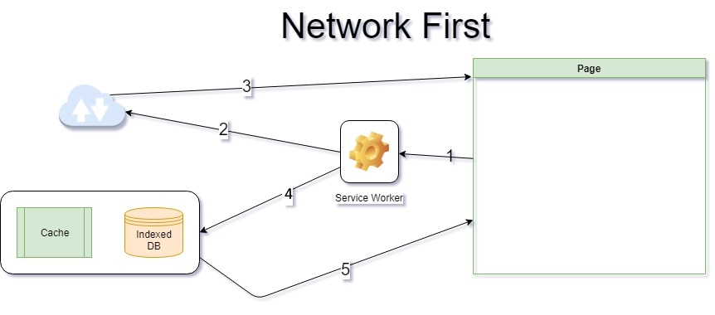

Slide 10
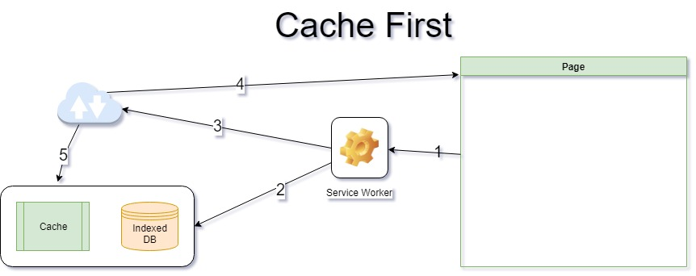

Slide 11
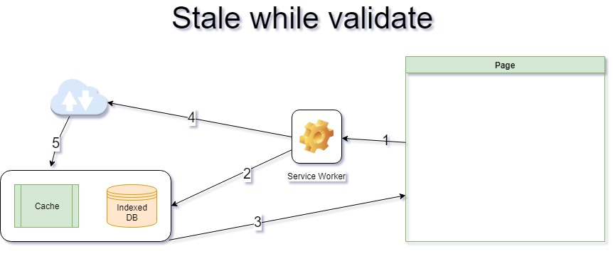

Slide 12

Caching Strategies
Race which ever comes back first
Background sync

Slide 13

Show me the code

Slide 14

Sample Tech Stack
Client
App Shell — UI Shell (i.e. React SPA)
Service Worker — Runs in the background
Fetch API / Cache API — Installation storage (code, assets and styles) workbox.js
IndexedDB — Dixie.js
Push Notification
Push Service
Subscription
Server
Asp.Net Core API for CRUD end points
MSSQL for data storage
MediatR as Message Bus (micro)
Push Service APIs

